Slide 1
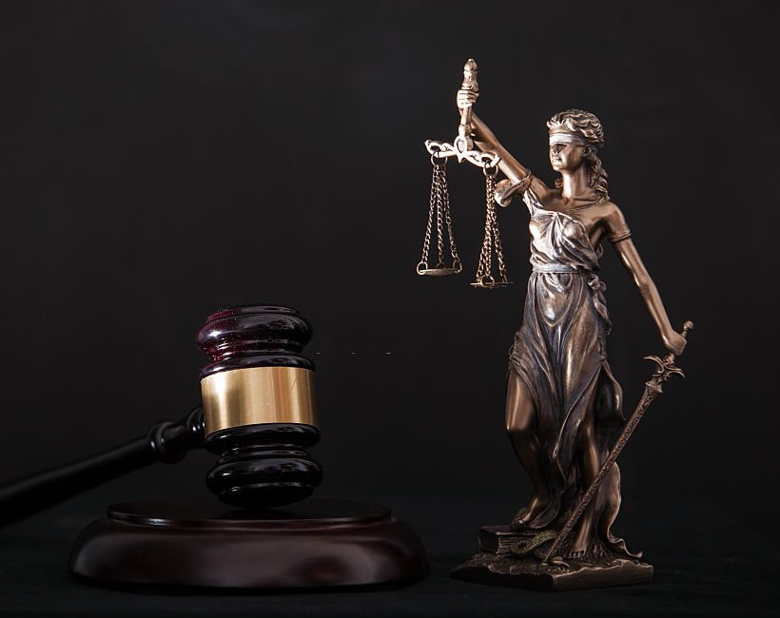
From Words to Strokes
Notes:
Good evening sir, this is our project from words to strokes

Slide 2
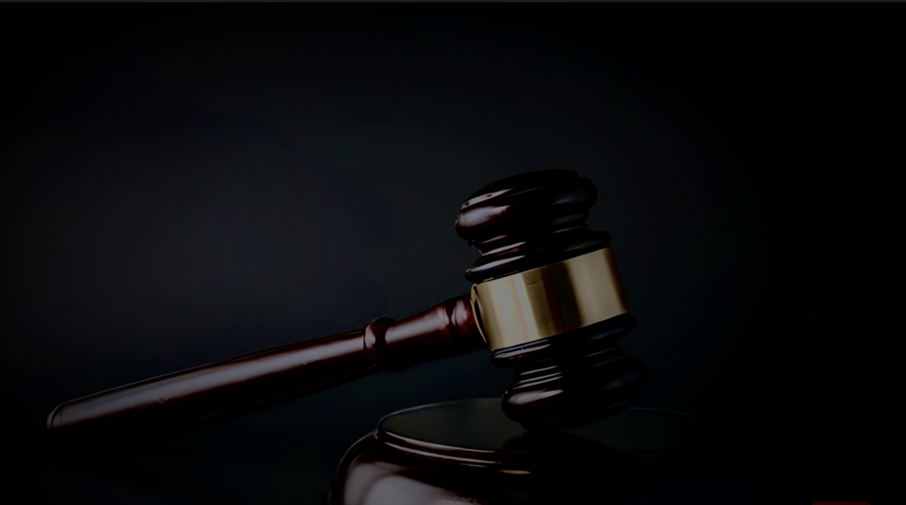
Project Details

Slide 3
Project Details
Title: From Words to Strokes
Project Number: 30
Guide: Dr. Rahul Pachauri
Our Team:
Sapeksh Pareek (211B274)
Sarthak Nagar (211B276)
Shivansh Bhatnagar (211B296)

Slide 4
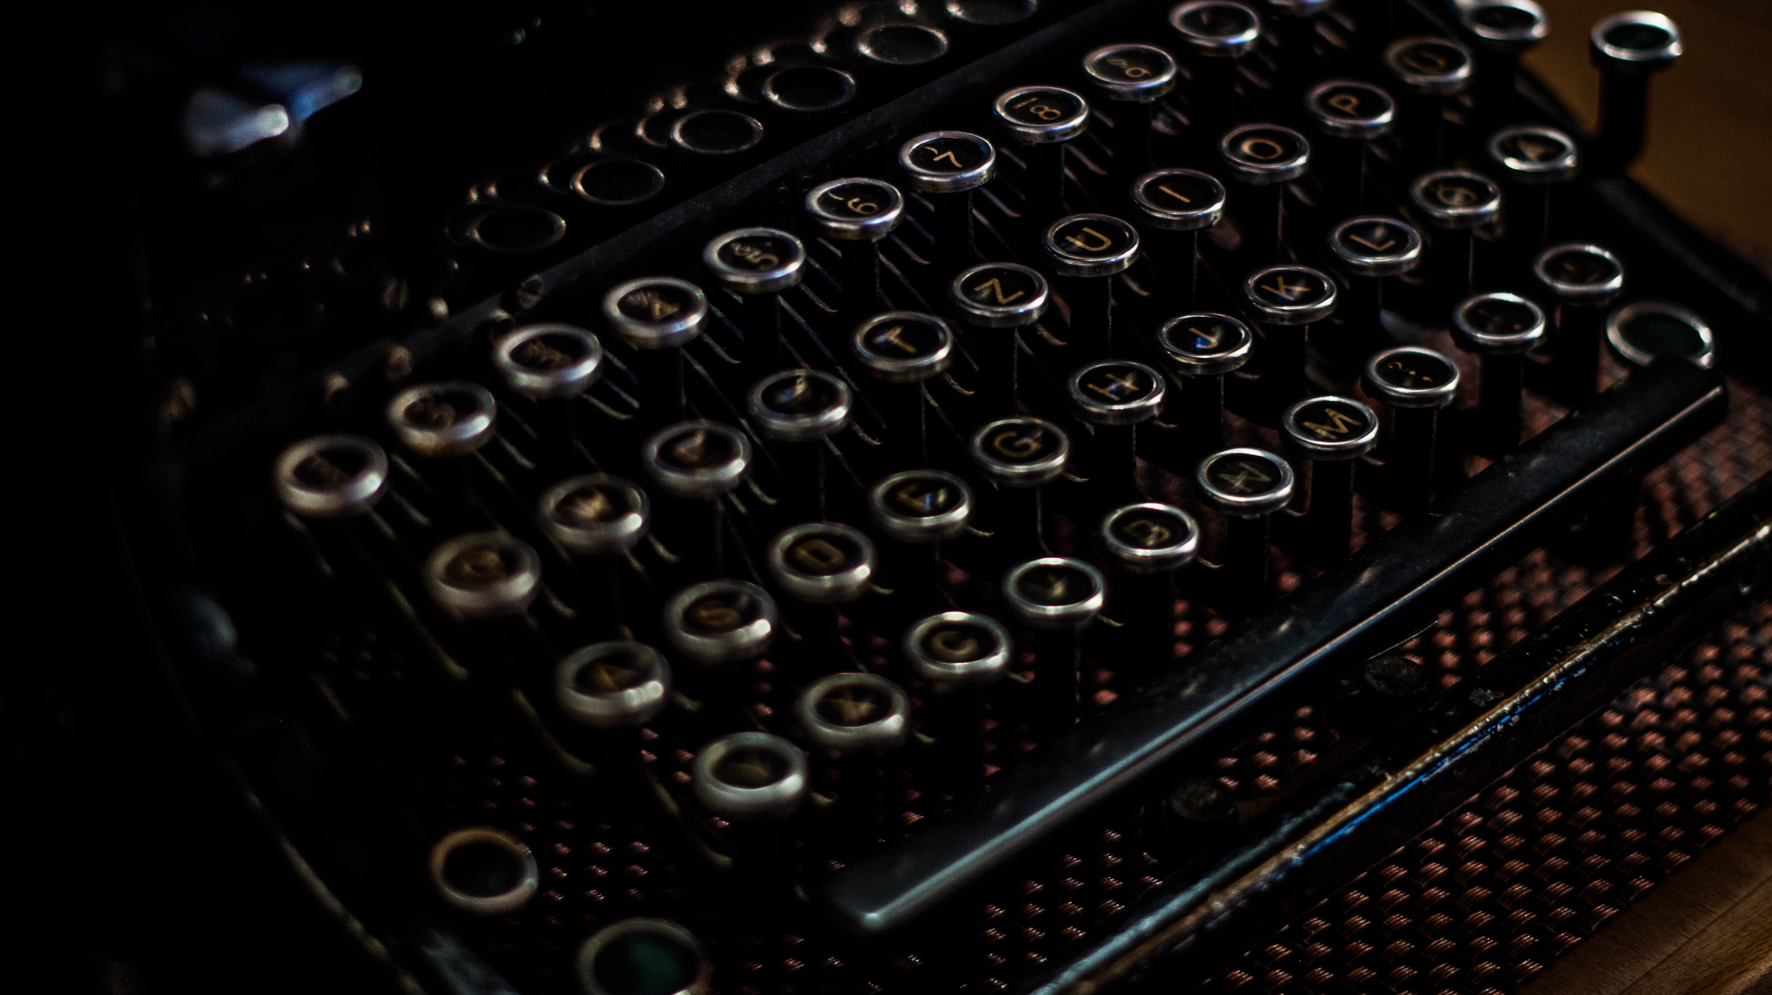
Project Details
hfvhhvhv
Minor Project Presentation -I
Our Team
Title: From Words To Strokes
Project Guide: Dr. Rahul Pachauri
Project No. : 30
Sapeksh Pareek (211B274)
Sarthak Nagar (211B276)
Shivansh Bhatnagar (211B296)
Notes:
Moving towards project details our project guide is dr Rahul pachuari and our project no. is 30 in our team I am Sapeksh Pareek and with my two collegues Sarthak nagar and Shivansh bhatnagar

Slide 5
Outline
Overview
System Architecture
Timeline
Synopsis
A transcribing tool that proficiently translates Hindi text into symbolic Rishi Pranali.

Slide 6
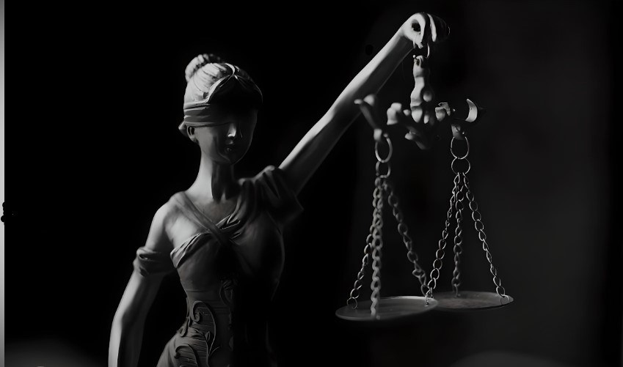
01 Overview
A Glimpse into our Project Methodology

Slide 7
About the Project
Developing an exclusive Rishi Pranali Digital Dataset.
In the Indian judicial system, Rishi Pranali is used to record all utterances made in courtrooms.
Utilizing Optical Character Recognition for the purpose of transcription.
To eliminate the risk of data breaches, we are developing our proprietary OCR system.
Notes:
Our project is about to create an exclusive dataset that hasn’t been created yet and its of rishi Pranali.
Rishi Pranali in is not a new term for Indian judiciary system, courts are using this from decades to record all the proceeding. Anything which is mentioned in a court hearing from the filing of the till verdict including all the statements given by victims, witnesses, advocates and judges. It is a symbolic language used by stenographer to record all these statements.

Slide 8
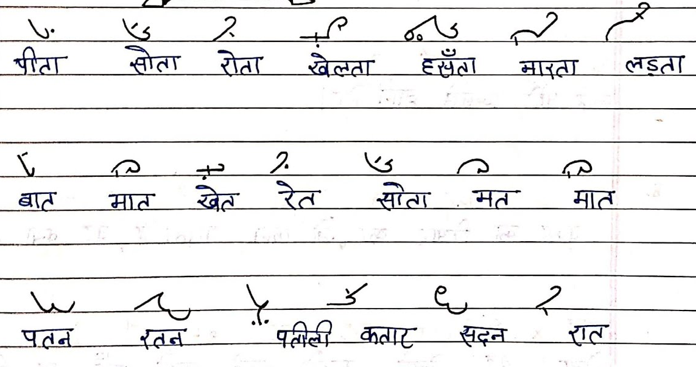
Examples how Rishi Pranali Looks.
Notes:
This is how rishi Pranali looks like.

Slide 9
Motivation for Project Idea
scghgsgxzzsh
The operational inefficiencies within the Indian Judiciary.
Generating an entirely unique dataset that is not currently in existence.
Contribute to the advancement of Digital India Initiative.
Ever wonder how AI works on Hindi Shorthand.
Notes:
Our motivation comes from the slowness in the Indian judiciary system. As there are lakhs of pending cases due to lots of paper work in courts, our small project can be a big contribution to speed us the work flow. By convering it digitally.

Slide 10
02 TechStack
Architectural Heartbeat of the System

Slide 11
TechStack
Python 3.9
PyTorch 2.0
Deep Learning
Tensor Flow
Recurrent Neural Network (RNN)
Region-based Convolutional Neural Network (R-CNN)

Slide 12
Deep Learning & Neural Networks
Deep Learning is a subset of machine learning that uses neural networks to solve complex problem.
TensorFlow is a powerful open-source machine learning framework.
PyTorch is a deep learning framework use in AI.
RNN is use for sequence modelling like text recognition.
R-CNN is object detection framework use for accurately localization for classification of images.

Slide 13
03 SystemArch
Architectural Heartbeat of the System

Slide 14
System Architecture
Dataset
Take available Hindi dataset to train our model.
Model
Design model using TensorFlow to work on Hindi input.
OCR
Take input in the form of Image or Text and generate abbreviated texts using Deep Learning.
Algo
Rishi
Using Proprietary algorithm for abbreviated text.
Output in the form of Rishi Pranali.

Slide 15
04 Timeline
A Step-by-Step Odyssey

Slide 16
Timeline
P1
P2
P2
P2
P3
P3
Research
Scrapping Images
Deep Learning
Building/ Training Model
Main Application
Dataset Creating

Slide 17
05 Synopsis
A Pithy Recap

Slide 18
Conlusion
In conclusion, we would like to convey that we have curated a dataset known as Rishi Pranali with the purpose of offering substantial assistance to the future initiatives of the Indian judiciary.

Slide 19
Thankyou!

